Slide 2
Projects-Based Arduino/Raspberry Pi Activities
Presenters:
Carl Frederickson, PhD University of Central Arkansas
Bala Maheswaran, PhD. Northeastern University
Robert Ross, PhD University of Detroit Mercy

Slide 3
Information you can download from the workshop
All of the starter codes and the two lab activities are available for download from Github.com.
https://github.com/drfred04/ASEE_workshop_2021.git
https://www.arduino.cc/en/software

Slide 4
Arduino Based Mechanics Activities
Motivation: “I don’t know, LoggerPro always does that for me”

Slide 5
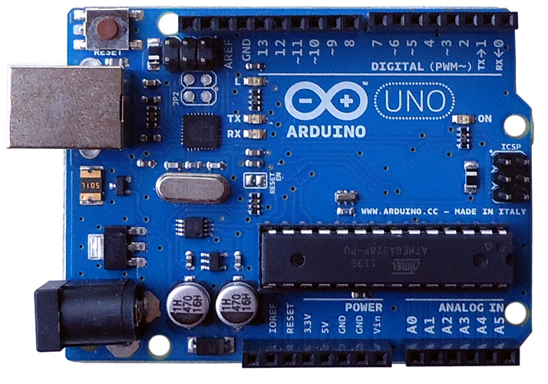
GND
Digital Input/Output
Reset Button
USB port
Analog Input
3.3 V
GND
5.0 V

Slide 6
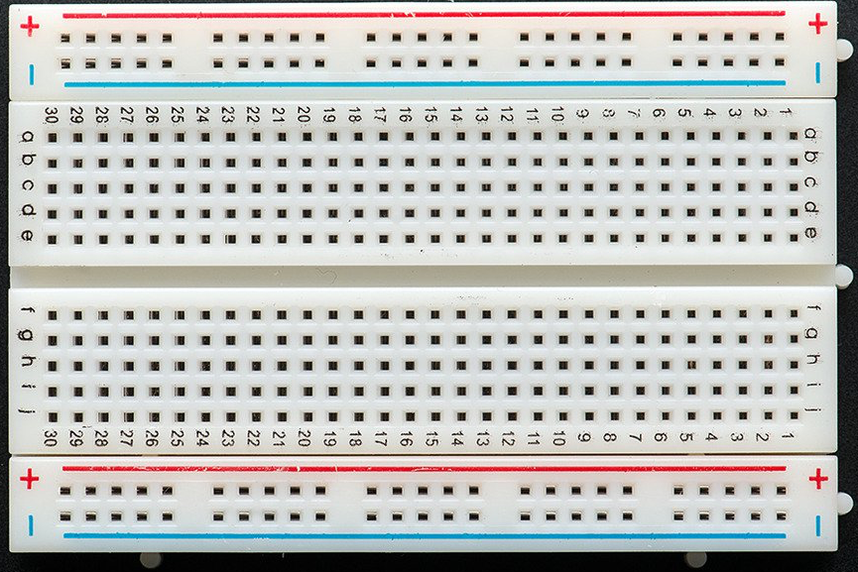

Slide 7
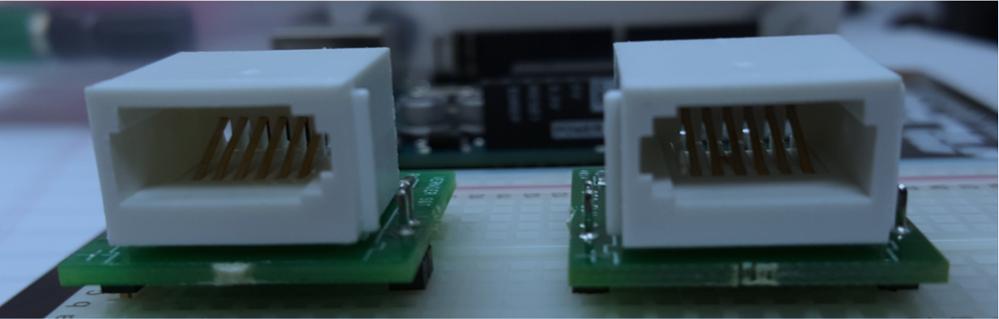
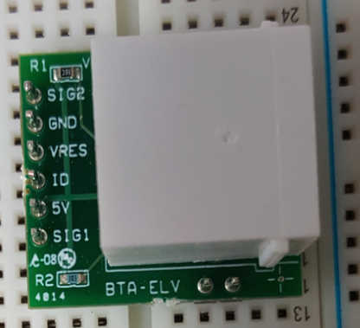
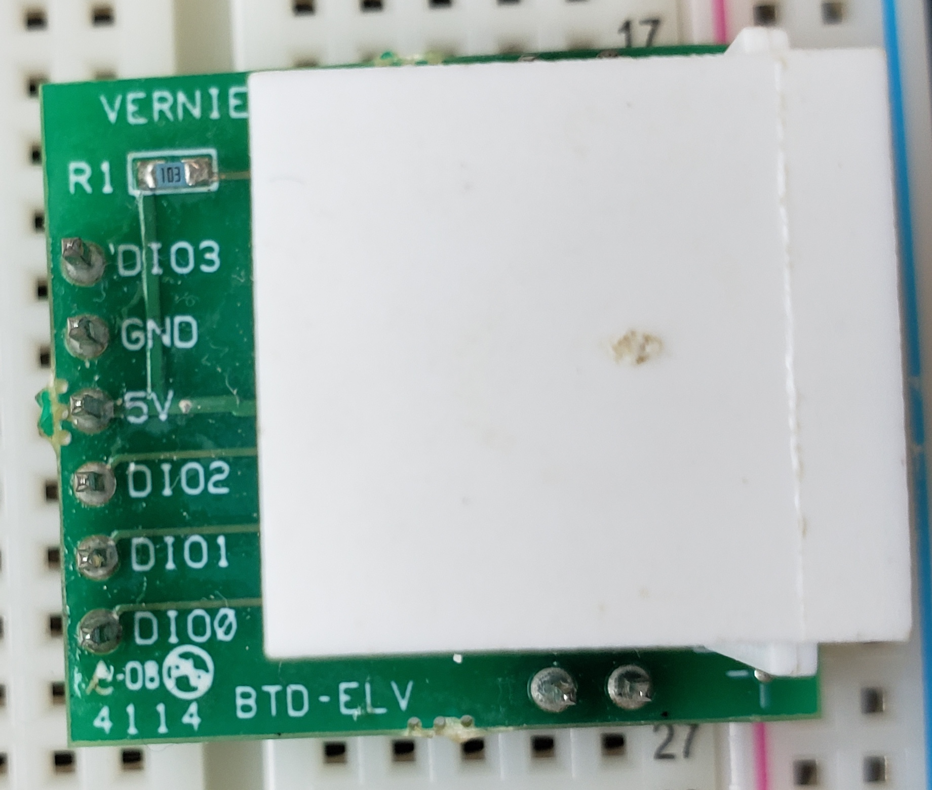
BTA-ELV
BTD-ELV

Slide 8
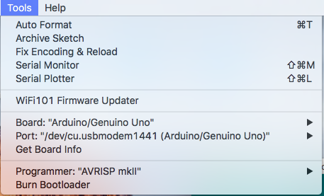

Slide 9
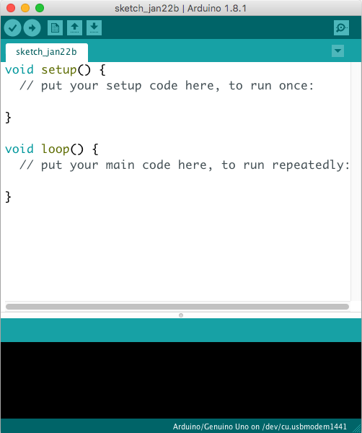
https://www.arduino.cc/en/software

Slide 10
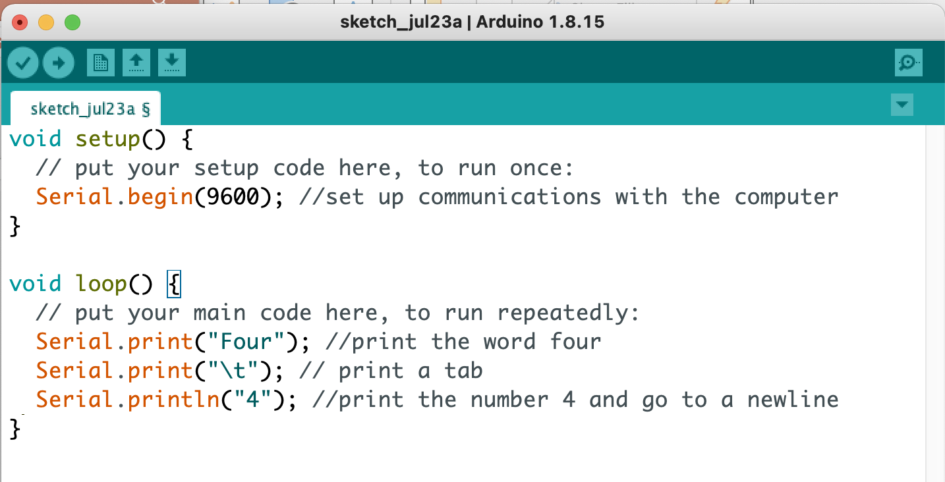

Slide 11
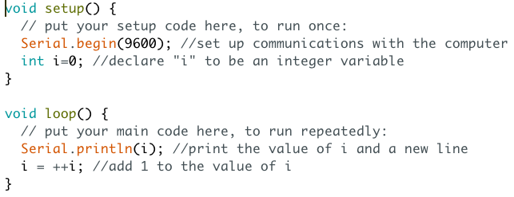
Using Variables
int
float boolean
char

Slide 12
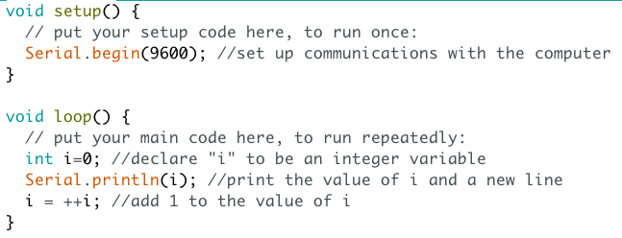

Slide 13
Activity 1: A calculation
What are the next 10 terms?

Slide 14
Activity 2
Motion Lab
Starter Code and handout are available on github.com.
https://github.com/drfred04/ASEE_workshop_2021.git
Original sketch file was downloaded from Vernier website.

Slide 15
Issues and Teaching Moments
The code is set to take a point every ¼ of a second. Is this fast enough given the motion being measured?
What information does the code output?
Almost every student will measure a speed of 0.017 cm/µs
Some students will note that each distance measurement occurs 0.25 s apart and come up with a reasonable speed.
Excellent time to talk about planning a measurement to obtain the information necessary to answer a question.

Slide 16
Activity 3
Lab 05 Force and Acceleration
Starter code on github.
Original sketch file downloaded from Vernier for a generic analog probe.

Slide 17
Issues and Teaching Moments
This activity allows you to discuss the draw backs to digitizing data.
The Arduino has a 10-bit digitizer, what does that say about the uncertainty of a voltage measurement?
Student’s must become familiar with the idea of calibrating their probes before using them.

